Slide 1
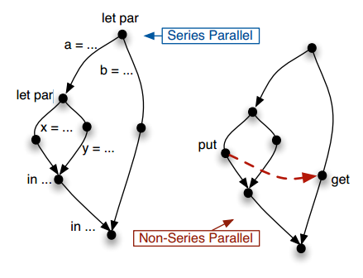
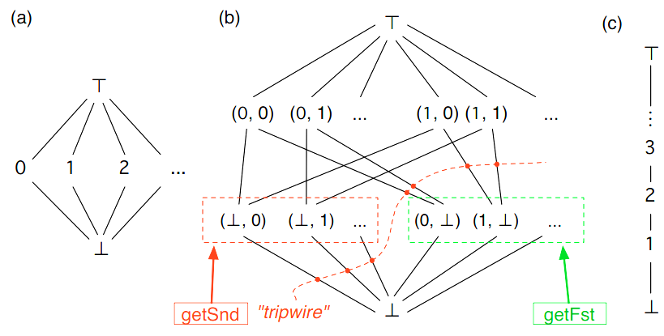
LVars For Parallel Programming
Isaiah Weating & Lindsey Kuper
Indiana University
Introduction
Parallel programming with state is hard. blah blah blah blah blah blah
Non Determinism blah blah blah generic definition
It is the interaction of being parallel and keeping state that is dfficult
let par a = ... let par x = ... y = ... in ... b = ... in ...
let par a = ... let par x = ... Put(l) ... y = ... in ... b = ... Get(l) ... in ...
Before I began working on this project, there was already an implementation of the linear lvar, c, that allows the user to put a value in and if you attempted to get a value, it will return true as long as that value doesn’t exceed the max value, the value that was put into the lvar.
Lvar B allows for pairs of values.
various headings..
The problem
Our contribution
Materials and methods should talk about redex anc rakkit
Isaiah Weating --- iweating@indiana.edu
Lindsey Kuper – lkuper@cs.indiana.edu

